Slide 1
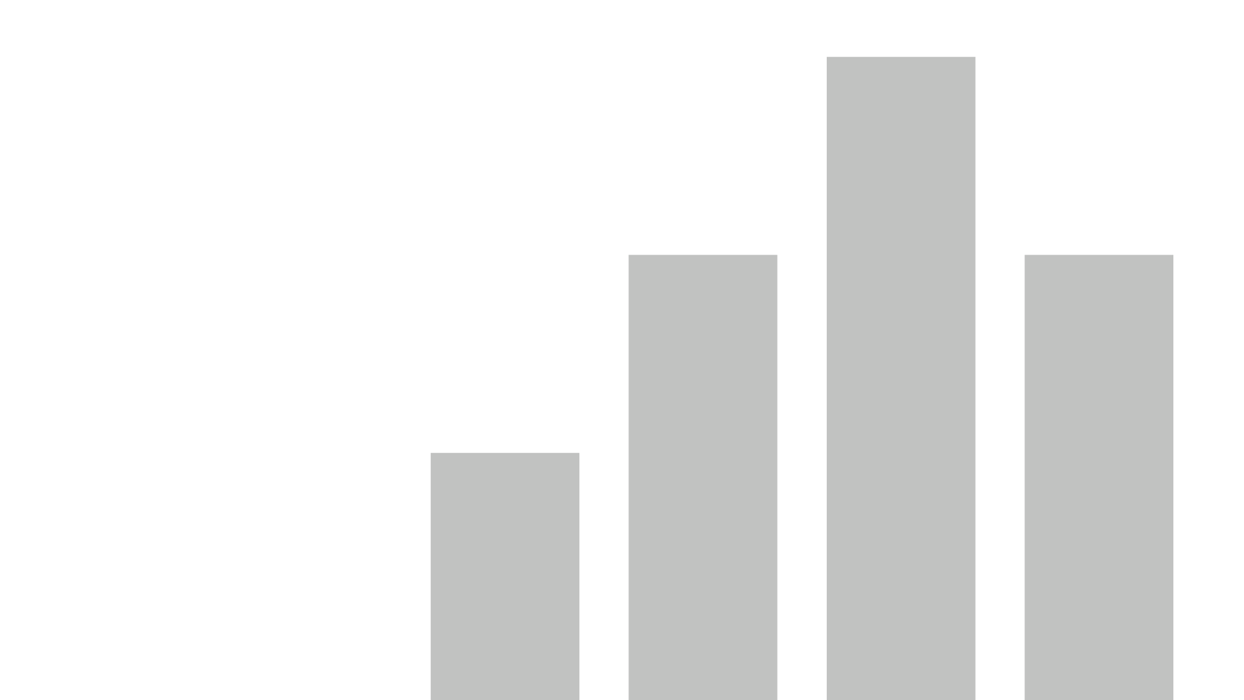


Organizational Lead Performance Visualization
View in Power BI
Last data refresh:
21-12-2023 18:19:51 UTC
Downloaded at:
21-12-2023 18:29:15 UTC

Slide 2
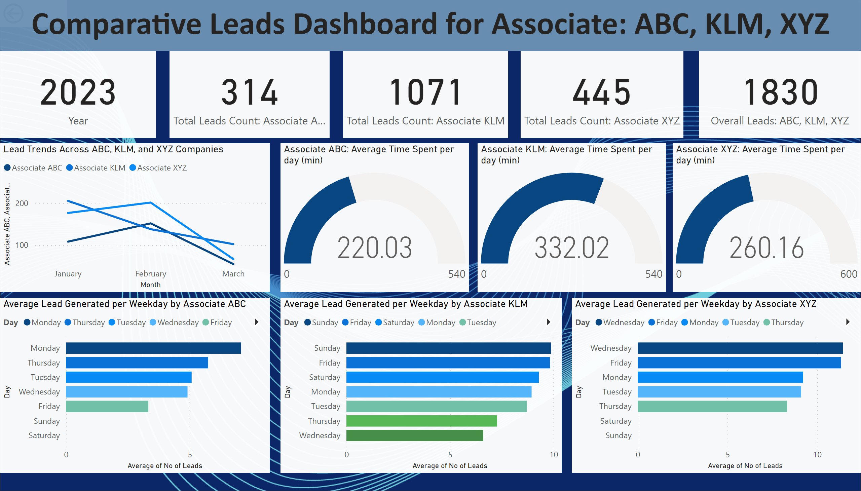
Page 1
Notes:
card
No alt text provided
card
No alt text provided
card
No alt text provided
card
No alt text provided
card
No alt text provided
actionButton
No alt text provided
Average Lead Generated per Weekday by Associate ABC
No alt text provided
Average Lead Generated per Weekday by Associate KLM
No alt text provided
Average Lead Generated per Weekday by Associate XYZ
No alt text provided
Lead Trends Across ABC, KLM, and XYZ Companies
No alt text provided
Associate ABC: Average Time Spent per day (min)
No alt text provided
Associate KLM: Average Time Spent per day (min)
No alt text provided
Associate XYZ: Average Time Spent per day (min)
No alt text provided
textbox
No alt text provided

